Slide 1
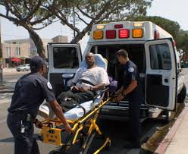

Forecasting Emergency Hospitalization Probability
Team: Bose (Aniruddha Bose & Goutam Bose) @ goutamb.apds01@mdpalumni.iimcal.ac.in

Slide 2
Background
Emergency hospital admissions are a major source of healthcare spending.
The growing availability of comprehensive clinical datasets, such as linked electronic health records (EHRs) with rich information from millions of individuals, together with advances in machine learning offers new opportunities for development of novel risk prediction models that are better at predicting the risk of unscheduled hospital admissions.

Slide 3
Solution Design
Machine learning uses statistical techniques to enable computer systems to learn from data; hence can be used to analyse electronic health records and predict the risk of emergency hospital admissions.
The objective of the solution is to develop a machine learning model that would enable healthcare workers to accurately monitor the risks faced by their patients, and as a result, make better decisions around patient screening and proactive care that can help reduce the burden of emergency admissions.

Slide 4
Methods Study design, data source, and patient selection
A prospective, observational, multicentre, multi-national cohort study was conducted using pseudo-anonymized patient data from various sources.
The retrospective study included medical patients seeking emergency department (ED) care that resulted in either admission or discharge.
Different predictors covering patient demographics (age, sex, and ethnicity), lifestyle factors (socioeconomic status, BMI, smoking status, and alcohol consumption), family history of chronic disease, various laboratory tests, prescribed medications, and records of previous emergency admissions can be used for the purpose.

Slide 5
Features & Target Variable
Variable | Definition
id | Patient ID
gender | Gender of Patient
age | Age of Patient
hypertension | 0 - no hypertension, 1 - suffering from hypertension
heart_disease | 0 - no heart disease, 1 - suffering from heart disease
ever_married | Yes/No
work_type | Type of occupation (Govt. Job/Private/Self-Employed/Never Worked)
residence_type | Area type of residence (Urban/Rural)
avg_glucose_level | Average Glucose level (measured after meal)
bmi | Body mass index
smoking_status | Patient's smoking status (Smokes/Formerly smoked/Never smoked)
admission_status | 0 - not admitted, 1 - admitted

Slide 6
Demographics
Predictor |  | Derivation cohort n = 34,720 | Validation cohort n = 8,680
Gender, n(%) | Female | 20,530(59.13) | 5,205(59.97)
 | Male | 14,190(40.87) | 3,475(40.03)
Age, mean (SD) |  | 42.23(22.51) | 43.57(23.73)
Ever married, n(%) | Yes | 22,351(64.38) | 5,587(64.37)
 | No | 12,369(35.62) | 3,093(35.63)
Hypertension, n(%) | Yes | 3,247(9.35) | 814(9.38)
 | No | 31,473(90.65) | 7,866(90.62)
Heart Disease, n(%) | Yes | 1,650(4.76) | 412(4.75)
 | No | 33,070(95.24) | 8,268(95.25)
Average Glucose Level (pp), mean (SD) |  | 104.48(43.11) | 105.57(43.73)
BMI | Missing, n(%) | 1,167(3.36) | 295(3.39)
 | Mean (SD) | 28.61(7.77) | 28.37(7.53)
Smoking Status, n(%) | Missing | 10,634(30.63) | 2,658(30.62)
 | Non-smoker | 12,842(36.99) | 3,211(36.99)
 | Ex-smoker | 5,994(17.26) | 1,499(17.27)
 | Smoker | 5,250(15.12) | 1,312(15.12)

Slide 7
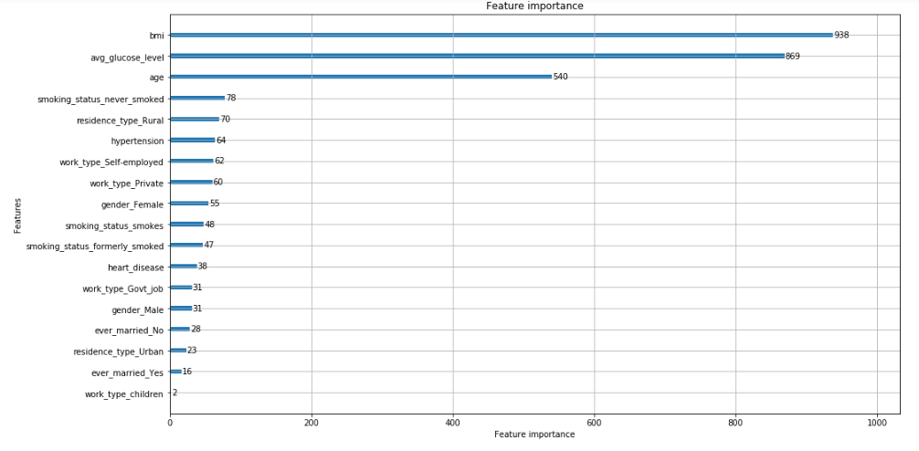
Feature Importance

Slide 8
Algorithm
Gradient boosting classifier (GBC) has been chosen as the model as it outperforms other machine learning models on a variety of datasets, is fairly robust and applicable to big datasets.
For validation purpose, 10-fold cross-validation has been used and the receiver operating characteristic curve (ROC-AUC) resulted 79% score.
Apart from the binary outcome (a patient being admitted or not), the probability of that patient belonging to class 1 (being admitted) is also predicted.

Slide 9
Confusion Matrix
Predicted | 0 | 1 | All
Actual
0 | 41,123 | 1,494 | 42,617
1 | 0 | 783 | 783
All | 41,123 | 2,277 | 43,400

Slide 10
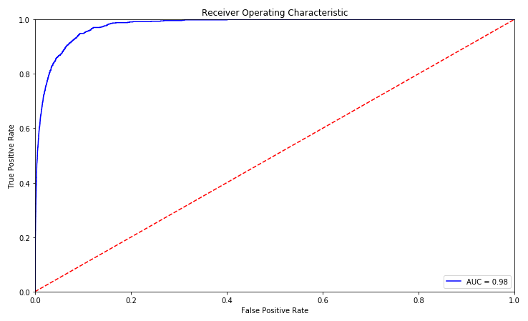
ROC-AUC Plot

Slide 11
Technology Stack
Python 3.6.5
pandas 0.23.4 (Python Data Analysis Library)
scikit-learn 0.20.1 (Python Machine Learning Library)
Flask 0.12 (Web Framework)
Jinja2 (Templating Language)
xgboost 0.81 (Gradient Boosting Library)

Slide 12
Steps Followed
Preprocessing of training data by i. Imputation of missing values in BMI and Smoking Status ii. One Hot Encoding of Categorical values (gender, occupation etc.)
Training of the model using XGBoost classifier with training data and validating the same with 10 fold cross-validation and saving the model using pickle (Python object serialization)
Developing a web application with Flask and deploy it to predict new patient status
Step 1
Data Preprocessing
(OHE, Imputation)
Step 2
Train & Validate
Save Model
Step 3
Deploy
Predict

Slide 13
Competitive Analysis and Area of Improvement
The proposed model can be compared with a high-performing Cox proportional hazards (CPH) model to assess whether the standard machine learning techniques could enhance the prediction of emergency hospital admissions.
The accuracy of the model can be increased significantly taking into account several other predictors like comorbidities, family history of chronic diseases, various clinical measures and laboratory test outcomes, prescriptions etc.
The model should be trained on a large volume of EHR for robustness.

Slide 14
Thanks! Questions?
Reach us at goutamb.apds01@mdpalumni.iimcal.ac.in

